Slide 1
Kubernetes Workshop
Competence Center
Cloud Platforms
Tom Verelst

Slide 2
Agenda
Introduction to Kubernetes
Deploying to Kubernetes
Service Discovery and Load Balancing
Storage
Exposing services
Secret and configuration management
Exercises

Slide 3
Kubernetes Introduction

Slide 4
What is Kubernetes?
Container Orchestration Platform
Kubernetes is an open-source system for automating deployment, scaling, and management of containerized applications.
Part of the Cloud Native Computing Foundation https://www.cncf.io/

Slide 5
Features
Automatic binpacking
Horizontal scaling
Automated rollouts and rollbacks
Storage orchestration
Self-healing
Service discovery and load-balancing
Secret and configuration management
Batch execution

Slide 6
Kubernetes Architecture

Slide 7
Pods
Containers within the same pod
Containers can find each other with localhost
Each pod has an IP address
Volumes are shared within a pod
Usually only one container
Multi-container pods only with monitoring/logging agents/…
Do not combine application + database in one pod

Slide 8
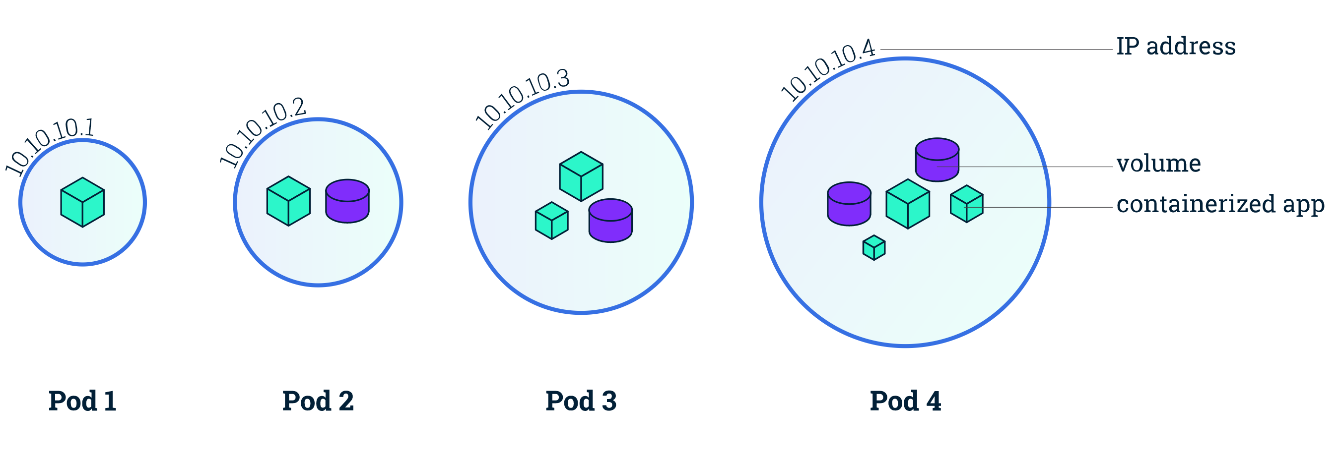
Pods

Slide 9
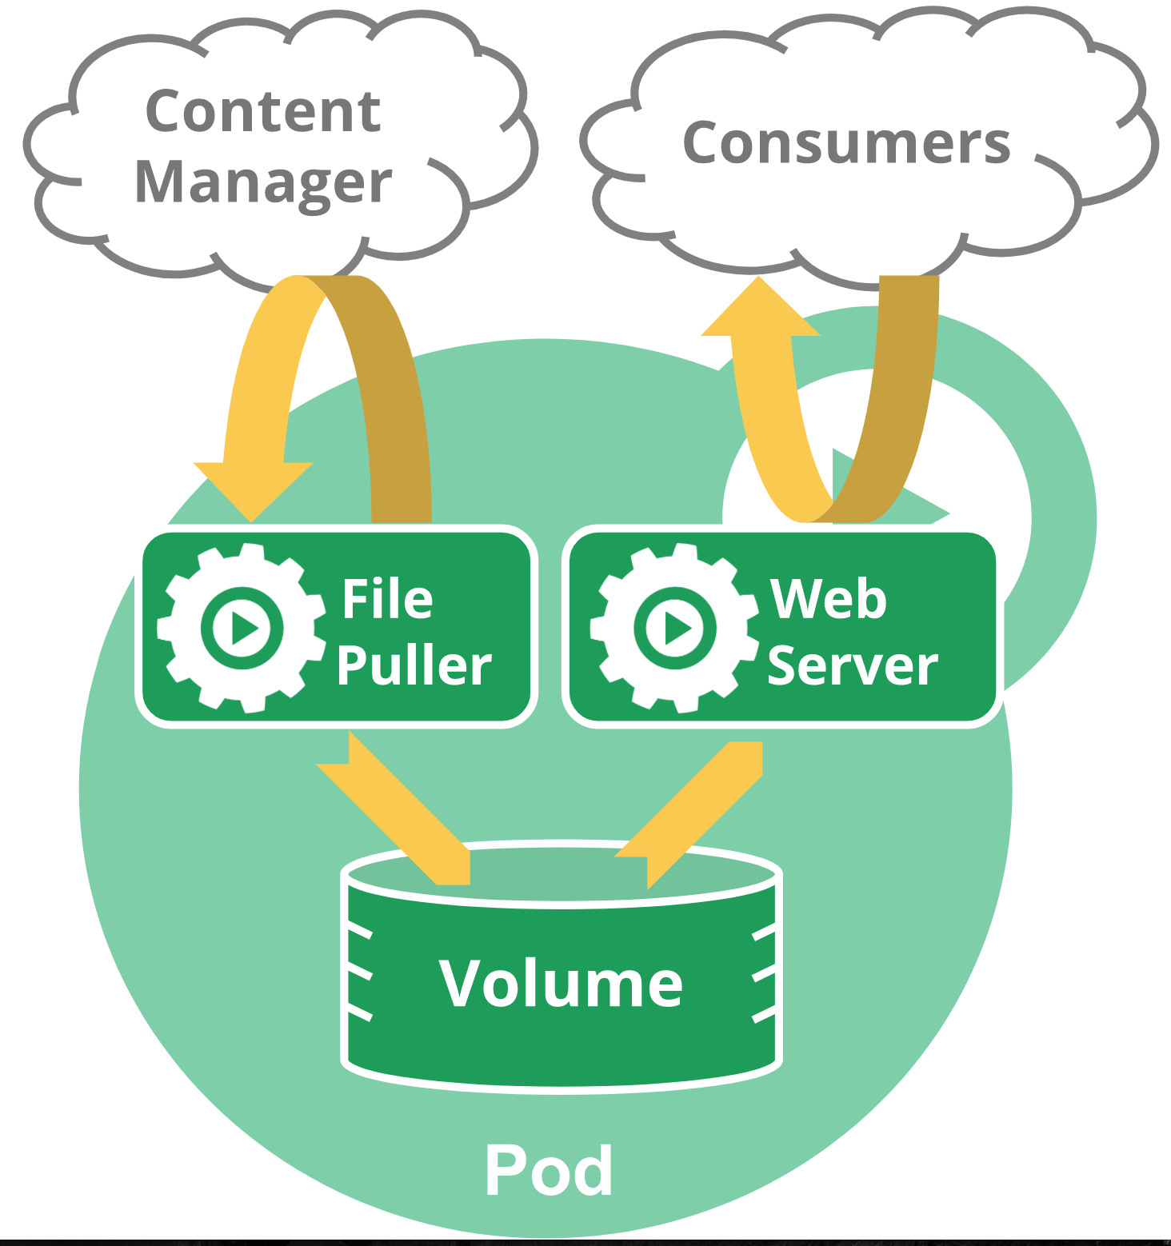
Pods

Slide 10
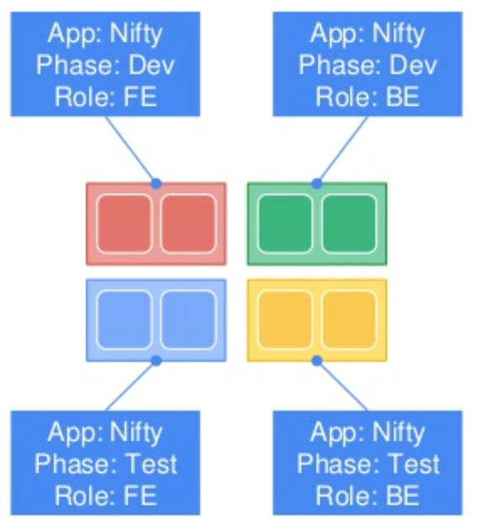
Labels
Arbitrary Metadata
Attached to any Resource
Represents Identity
Queryable by Selectors
The only grouping mechanism

Slide 11
Selectors
Equity-based selector
environment=production,tier=frontend
Set-based selector
environment in (production),tier in (frontend)

Slide 12
Deploying to Kubernetes

Slide 13
Deploying Pods
Replication Controller
Replica Set
Deployment
Daemon Sets

Slide 14
Replication Controller
Desired state
Controls the amount of replicas

Slide 15
Replica Set
Replica Set
Same as ReplicationController
Supports the new Set-based selectors

Slide 16
Deployment
Common way of deploying
Manages the ReplicaSets for you
Supports rolling updates
Deployment
Replica Set

Slide 17
Rolling Updates

Slide 18
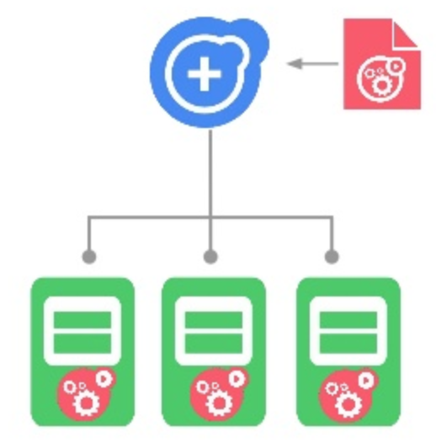
Daemon Set
Runs a pod on every node
Or a select few of them
Not a fixed number of replicas
Depends on the amount of selected nodes
Useful for cluster-wide services
E.g. logging or monitoring agents

Slide 19
Local Setup

Slide 20
Local Setup
https://https://github.com/tomverelst/kickstarter-kubernetes
kubectl
Minikube (requires a VM like VirtualBox)

Slide 21
Kubectl
Command line tool that talks to the Kubernetes API server https://kubernetes.io/docs/tasks/tools/install-kubectl/
macOS
$ brew install kubectl
Windows
$ choco install kubernetes-cli
Config is in ~/.kube/config

Slide 22
Minikube
A local Kubernetes cluster
https://github.com/kubernetes/minikube/releases
Generates kubectl config $ minikube version
minikube version: v0.23.0
$ minikube start --kubernetes-version v1.10.0

Slide 23
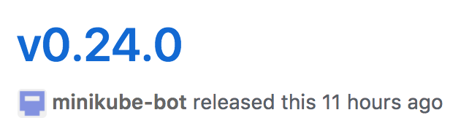
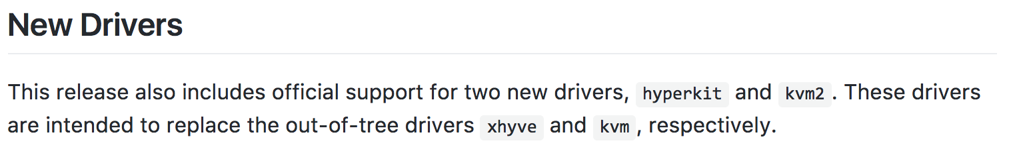
New release!

Slide 24
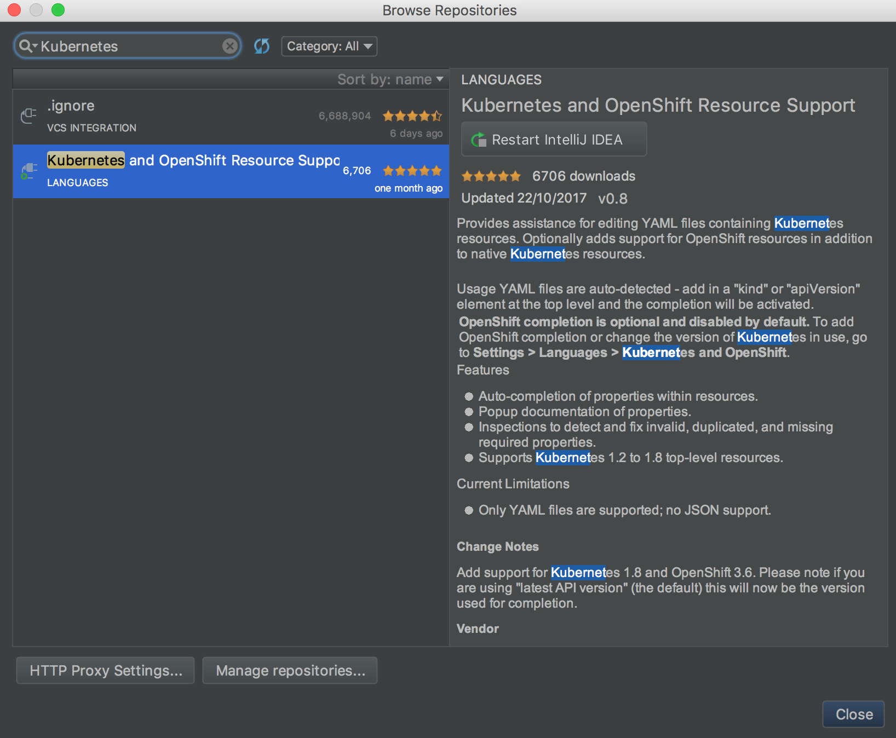
IntelliJ plugin

Slide 25
Minikube commands
# Start cluster
$ minikube start --kubernetes-version v1.10.0 --memory 4096
# Delete cluster
$ minikube delete
# Get IP from the cluster
$ minikube ip
# Open Kubernetes Dashboard
$ minikube dashboard

Slide 26
Kubernetes Objects
Everything is a Kubernetes Object (API Object)
Always has a spec and a status
Defined in .yaml files

Slide 27
Kubectl commands
$ kubectl get <resource type>
$ kubectl get pods
$ kubectl get services
$ kubectl get svc

Slide 28
Kubectl commands
$ kubectl create -f file.yaml
$ kubectl apply -f file.yaml
$ kubectl delete -f file.yaml
$ kubectl delete pod <pod-name>
$ kubectl apply -f afolder
$ kubectl delete -f afolder

Slide 29
Kubectl commands
$ kubectl logs <pod name>
$ kubectl describe pod <pod name>
$ kubectl describe svc <service name>

Slide 30
Kubectl commands
$ kubectl proxy (minikube dashboard)
http://localhost:8001/api/v1/proxy/namespaces/kube-system/services/kubernetes-dashboard/#/namespace?namespace=default
Make a pod accessible locally!
$ kubectl port-forward <pod-name> <port>

Slide 31
Demo Application
https://github.com/tomverelst/kickstarter-kubernetes

Slide 32
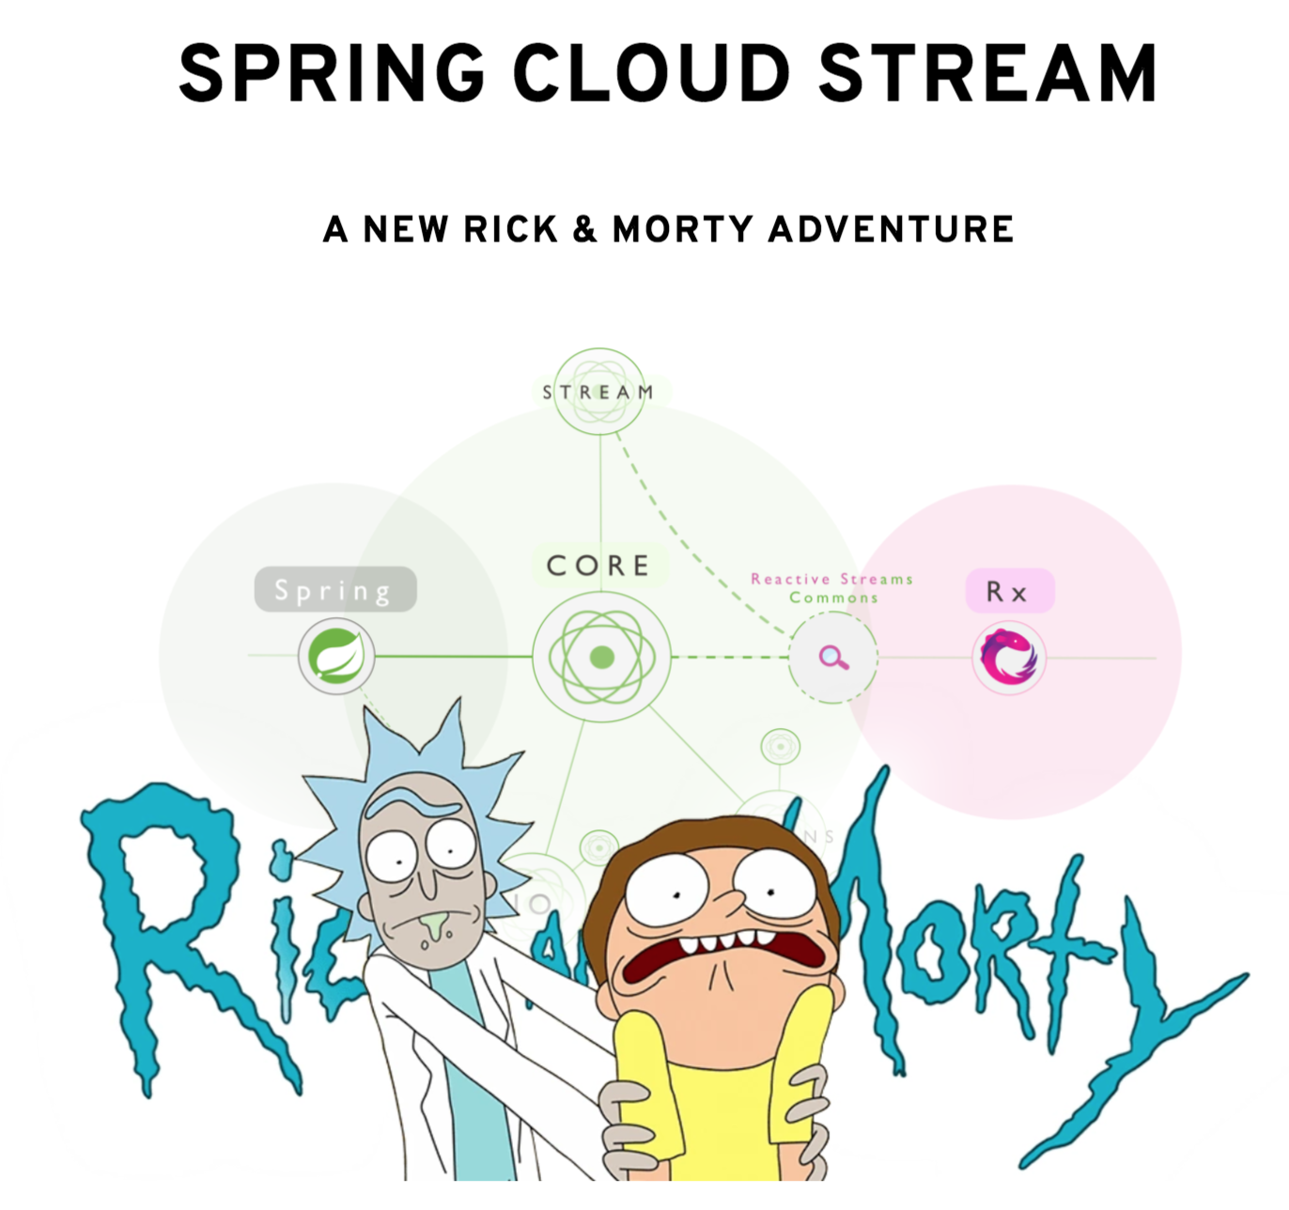
Demo Application
A Rick & Morty adventure!
Originally for CloudFoundry
Ported to Kubernetes
Credits to Dieter Hubau

Slide 33
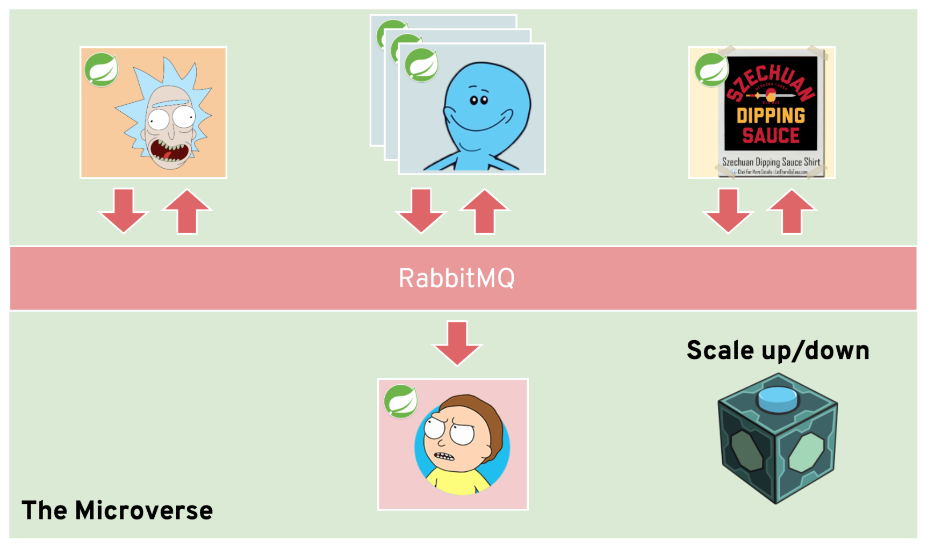
Architecture

Slide 34
Let’s deploy!

Slide 35
Service Discovery &
Load Balancing

Slide 36
Service
Service discovery
Automatic load balancing
Uses selectors to select pods
Creates “Endpoint” resources

Slide 37
Service Types
ClusterIP (default)
Exposes the service on a cluster-internal IP.
Load Balancer
External load balancer
NodePort
Expose the service on each node with a randomly allocated port
ExternalName
Maps to an external service

Slide 38
Name spaces
Virtual clusters
Default namespace is default
Divide cluster resources between users/teams

Slide 39
Service Discovery through DNS
Each service gets assigned a DNS name
A service named foo in the default namespace is discovable through DNS as foo A Record: foo.default.svc.cluster.local

Slide 40
Service Discovery through DNS
A service named foo in the bar namespace is discoverable through DNS as foo.bar A Record foo.bar.svc.cluster.local

Slide 41
Replication + Services

Slide 42
Let’s create our services!

Slide 43
Storage

Slide 44
Persisting Data
Persistent Volumes
Persistent Volume Claims
Storage Class
Dynamic Volume Provisioning

Slide 45
Persistent Volume
Defines a mountable volume
Local disk
EBS
Google Cloud Disk
…
Admin / OPS owned

Slide 46
Access Modes
ReadWriteOnce
the volume can be mounted as read-write by a single node
ReadOnlyMany
the volume can be mounted read-only by many nodes
ReadWriteMany
the volume can be mounted as read-write by many nodes

Slide 47
Persistent Volume Claim
Claims a Persistent Volume using a selector for a pod
After claiming, the pod can access the volume
If no PV can be claimed, the PVC will be “pending”
Developer owned

Slide 48
Claiming a Persistent Volume

Slide 49
Storage Class
Admins can create profiles of the storage they offer
Extra abstraction between volumes and claims

Slide 50
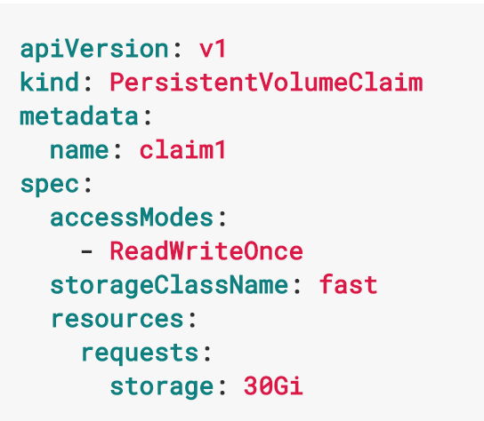
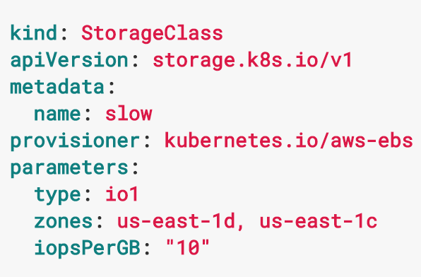
Storage Class

Slide 51
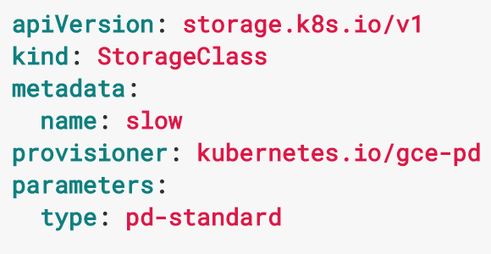
Dynamic Volume Provisioning
Allows volumes to be created on-demand
Requires Storage Classes with a provisioner

Slide 52
Let’s persist our data!

Slide 53
Exposing services

Slide 54
Exposing Services
Ingress Controller
Ingresses

Slide 55
Ingress Controller
Routes traffic to the correct service
Automatically updated
nginx, HAProxy, …
Configure TLS

Slide 56
Let’s expose our services!

Slide 57
Setup Ingress Controller
$ minikube addons enable ingress
Will create an nginx Ingress controller

Slide 58
Annotations
Similar to Labels
(Arbitrary) Metadata
Attached to any Resource
Not queryable by Selectors
Intended for configuration, build information, pointers for logging/monitoring agents, etc..

Slide 59
Secret & configuration
management

Slide 60
Secret & Configuration Management
Secret
ConfigMap

Slide 61
Secret
Holds sensitive information like passwords, OAuth tokens, ssh keys, …
Secrets are base64 encoded
Can be mounted or consumed through an environment variables

Slide 62
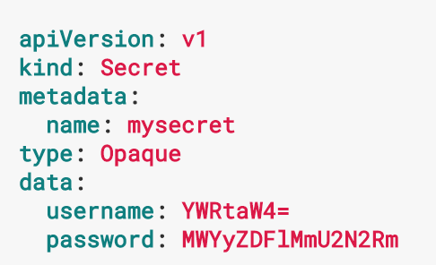
Create secret

Slide 63
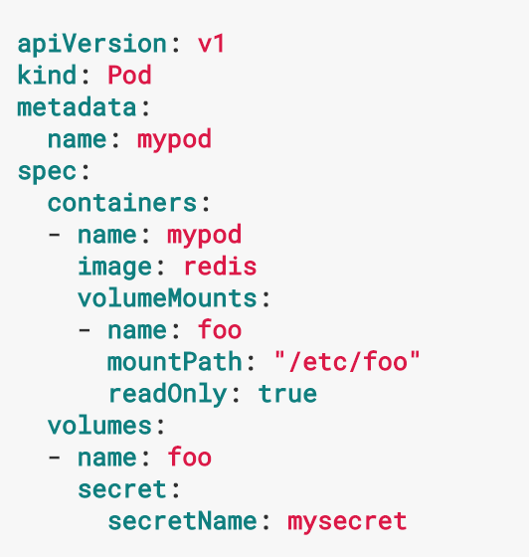
Mount Secret

Slide 64
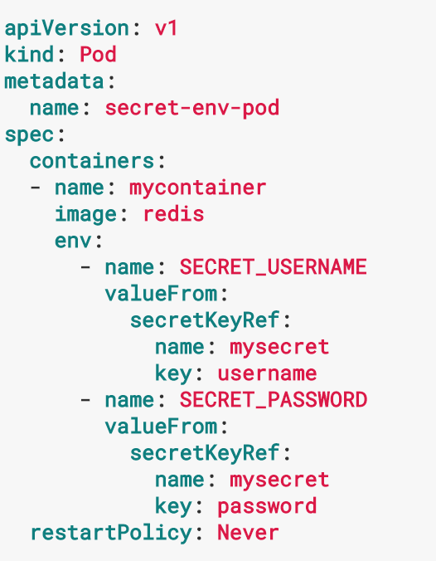
Secrets in Environment Variables

Slide 65
ConfigMap
Decouples configuration from images
Can contain files (--from-file)
Can contain key value pairs (--from-literal)

Slide 66
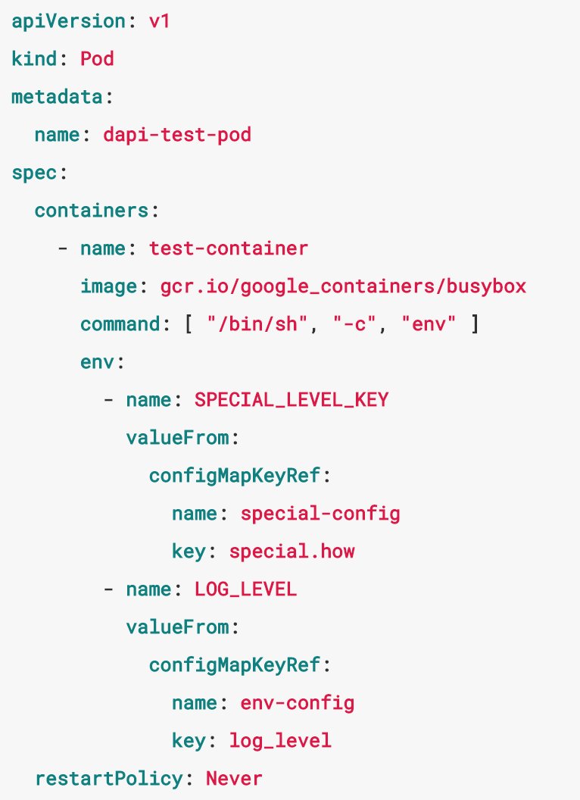
Environment Variables

Slide 67
Let’s configure!

Slide 68
Final Result

Slide 69
Extra
Helm - A package manager for Kubernetes https://github.com/kubernetes/helm https://github.com/kubernetes/charts
Draft - Containerizes applications for Kubernetes using build packs (à la CloudFoundry), uses helm, in beta https://github.com/azure/draft
kube-lego - Automatically request certificates for Kubernetes Ingress resources from Let’s Encrypt https://github.com/jetstack/kube-lego

Slide 70
Questions?

Slide 71
Thanks!

